Slide 1


Capstone Project Phase A
24-1-D-39
Angel Hands
sign Language Learning Game
Presented by:
Eitan German
Dolev Almog
Supervisor:
Moshe Sulamy

Slide 2

Angel Hands A Revolutionary Sign Language Teaching Game. Today More Than ever There is a focus on language learning apps. But one language fell between the cracks and it’s the sign language As of Today there are no high quality games to teach ASL. Our Goal is to make ASL learning fun and Accessible to everyone from everywhere
Notes:
Angel Hands
A Revolutionary
Sign Language
Teaching Game.
Now More Than ever
There is a focus on language learning apps.
But one language
fell between the cracks
and it’s the sign language
As of Today
there are no high quality games to teach ASL.
Our Goal
is to make ASL learning
fun and Accessible to everyone from everywhere

Slide 3
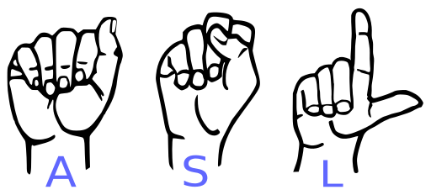
What Is ASL?
ASL is the American Sign Language:
Using Hands to Talk
More Than Hands Gestures
It's a Real Language
Evolving
Communities
Notes:
Using Hands to Talk: ASL is a way people talk using their hands instead of their voice. They use different shapes and movements of their hands to say words (don’t rely on only on your voice).
More Than Hands Gestures: ASL isn't just about making hand shapes for words; people also use their face, body, and the space around them to help tell the whole story (Involving the body to emphases feelings and being ).
Example of using mouth as well: https://www.youtube.com/watch?app=desktop&v=hCIA7vqjcwM
It's a Real Language: Just like English or Spanish, ASL has its own rules for how to put signs together to make sentences.(Rules - Grammer)
Evolving: ASL has grown and changed over time as people who use it have learned signs from each other and created new ones.(Improving - Slang)
Communities: Lots of people use ASL, not just those who can't hear. Some are kids whose parents can't hear, and they use ASL to talk at home.(known language with audience)
70 million hearing-impaired and deaf people all over the world use sign language to communicate.
In the United States, 500,000 hearing-impaired and deaf people use American sign language (ASL).

Slide 4
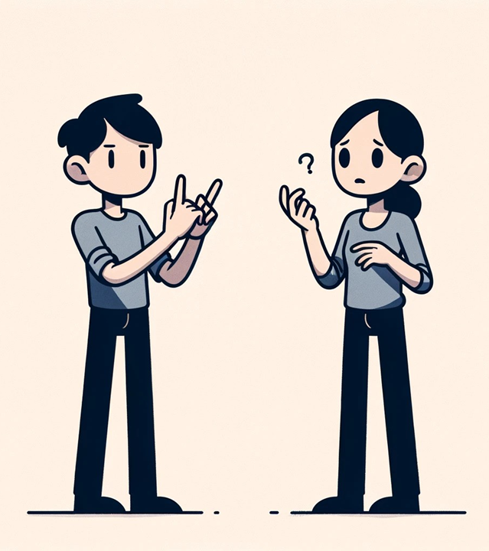
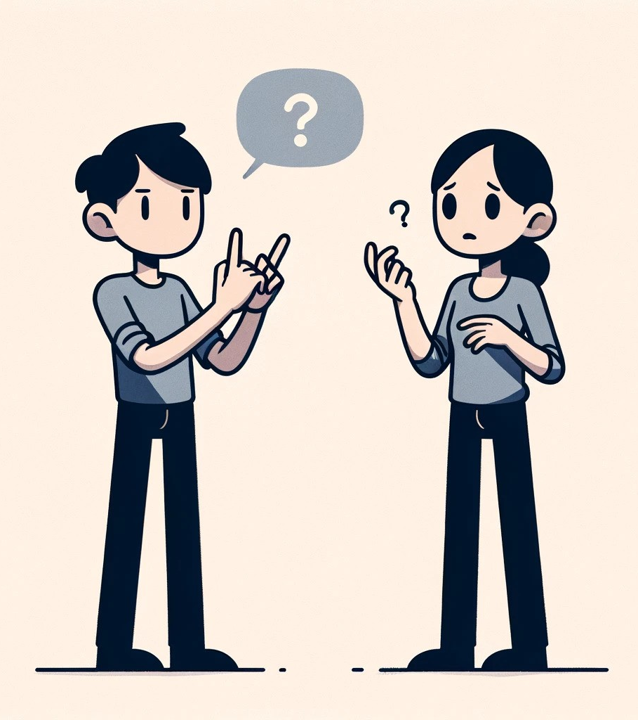

The Power Of Communication
Connections
Teamwork
Opportunities
Emergency
Notes:
The Importance of ASL knowledge – Considering how uncommon ASL is
Connections: Humans like to have friends, so I've heard.
Teamwork: Changing ideas and giving instructions. Taking part in society.
Opportunities: In a relevant situation putting ourselves where we can make change and affect it.
Emergency: the instinct is to ask for help when you are in danger or bad situation.
Pointing out:
Asking a hearing-impaired person to write down what they want to say is not a proper solution

Slide 5
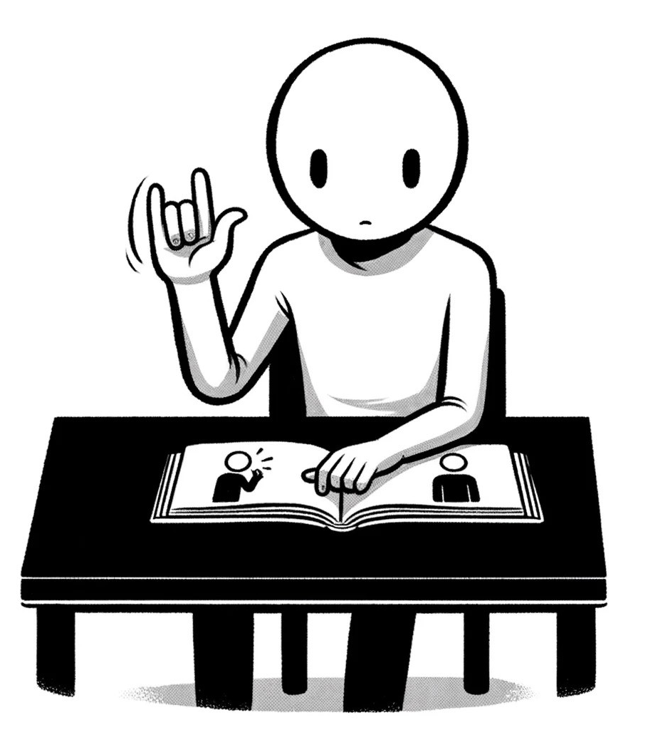
Challenges Of Learning ASL
Visual-Spatial Nature
Grammar and Syntax
Practice and Exposure
Irrelevant
Notes:
Why haven’t you learned ASL
1.Visual-Spatial Nature: ASL is a visual and spatial language. This means learners must adapt to using their eyes to understand language instead of their ears, and they must be aware of how signs are shaped and oriented in space​.
2. Grammar and Syntax: ASL has its own unique grammar and syntax that differs significantly from spoken English. Learners must grasp these differences to become proficient, which involves understanding the structure of sentences and the specific ways in which signs are modified or combined to convey different tenses and grammatical aspects​
3. Practice and Exposure: Like any language, fluency in ASL comes with practice and exposure. Engaging with the Deaf community and practicing signing in real-life situations are crucial for developing a good understanding and fluency in the language​.
4. Irrelevant: there's no one that you know at the point of your life that it might help with.

Slide 6

Our Mission Make ASL Accessible

Slide 7
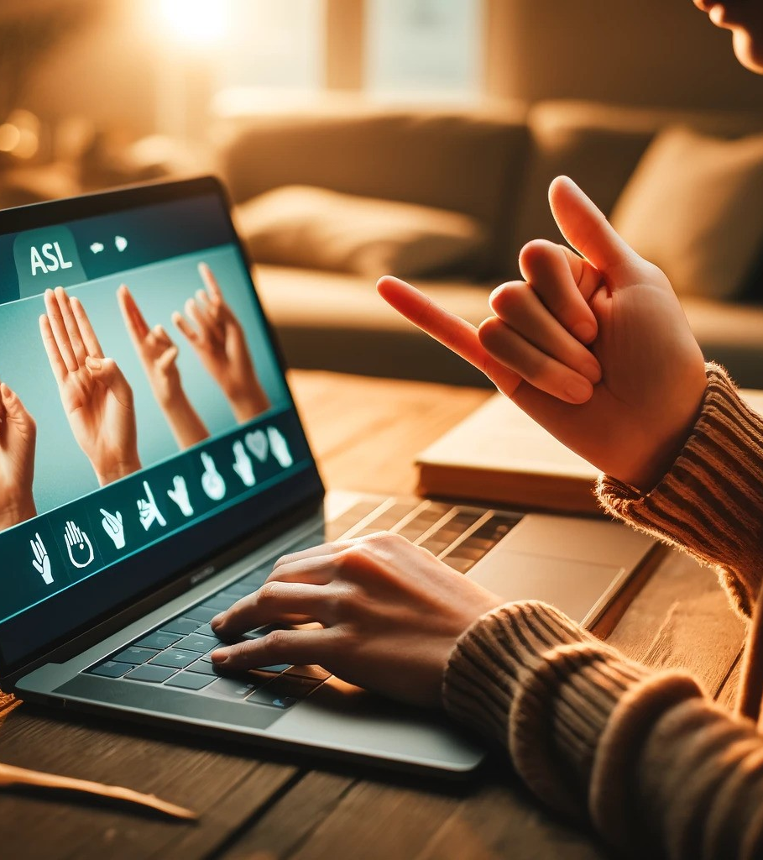
SOLUTION Unity GAME
Creating an educational, fun video game that will attract people to play and learn the American Sign Language.
KEYPOINTS:
Using hands gestures to control the game (ASL).
Making the game enjoyable and informative.
Fast Response to users' hands and keep gameplay flow
Notes:
So, our solution would be to create a unity game.
Our goal is to create an fun and educational video game that would attract anyone to play and learn the American sign language.
Keypoints:
Using hand Gestures to control the game (asl) – conventional games use only the mouse and keyboard we need to find a way to integrate sign language within the game.
Making the game enjoyable and informative – Most people agree that learning is not very fun, it can be frustrating and difficult, we strive to create a game that would be fun and enjoyable for long hours.
The game must also be accurate and informative since we are actually tring to teach a language here.
3. Fast response – the sign language recognitnion should be fase and accureate in order to prevent frustration among the users.

Slide 8
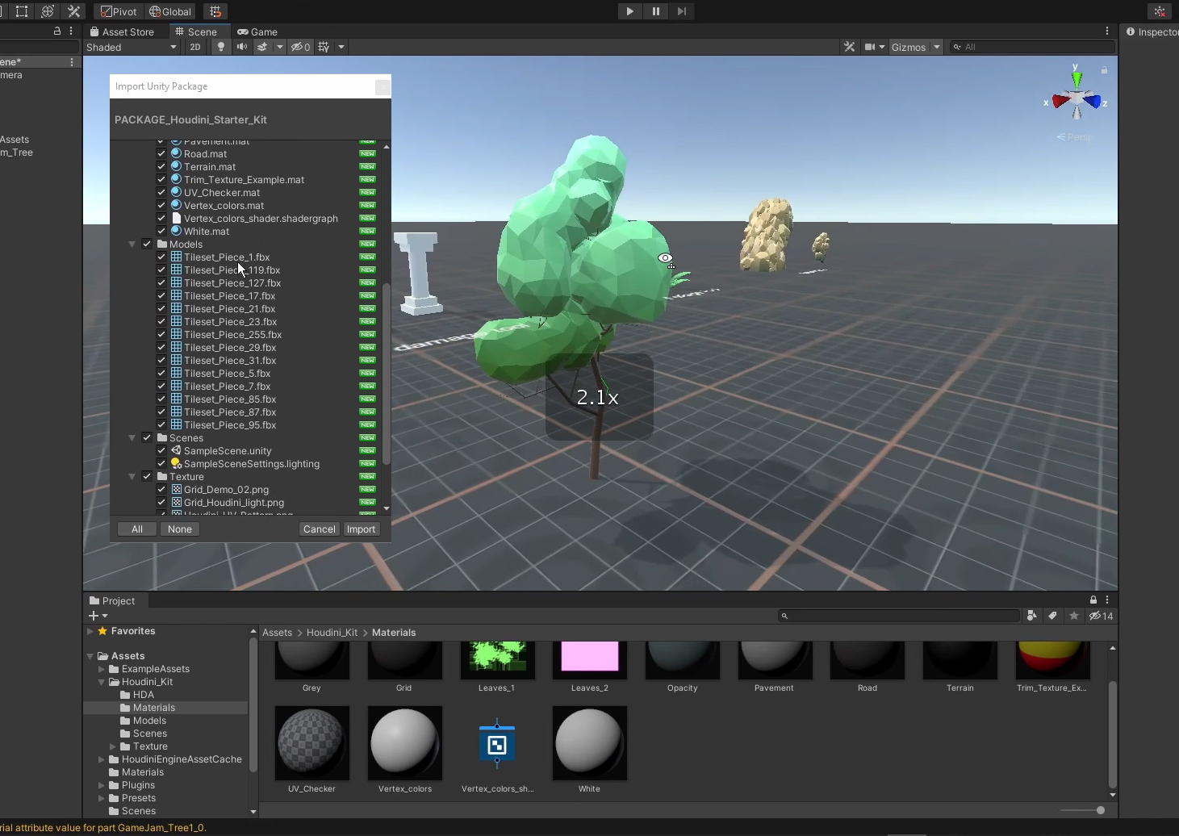
Unity Engine
Cross-platform development
Scripting with C#
Support 2D and 3D Graphics
Physics Engine
Asset Store
A Solid and Helpful Community
Notes:
Cross-Platform Development: Unity allows developers to build their projects for multiple platforms including Windows, macOS, Linux, iOS, Android, AR/VR devices, consoles, and more, all from a single source.
Scripting with C# is used for most tasks within Unity, including gameplay mechanics, user interface, AI behavior, and more.
Graphics: Unity supports both 2D and 3D graphics rendering, HDR lighting, real-time global illumination powered by Enlighten, and customizable shaders using Shader Graph. It also supports ray tracing for achieving photorealistic rendering.
Physics Engine: Unity incorporates PhysX by NVIDIA, which provides realistic handling of physical simulations. This engine supports the simulation of rigid bodies, cloth, fluid, and particle systems.
Asset Store: Unity has an extensive asset store where developers can buy and sell assets, tools, and plugins, which can significantly accelerate development processes.
A Solid and Helpful Community : nearly 2.5 million developers utilize the Unity programming environment.

Slide 9
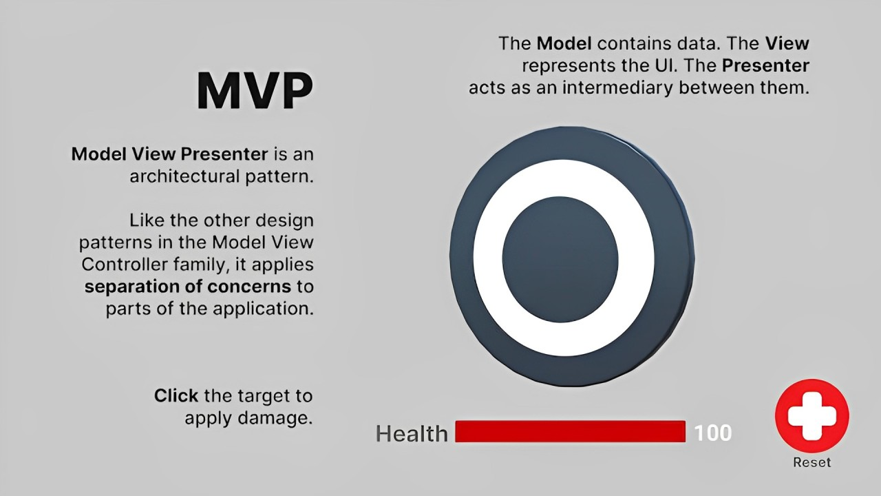
Notes:
https://unity.com/how-to/build-modular-codebase-mvc-and-mvp-programming-patterns
In MVP, the Presenter (called the Controller in MVC) acts as a go-between for the other layers. It retrieves data from the Model and then formats it for display in the View. MVP switches which layer handles input. Rather than the Controller, the View is responsible for handling user input.

Slide 10
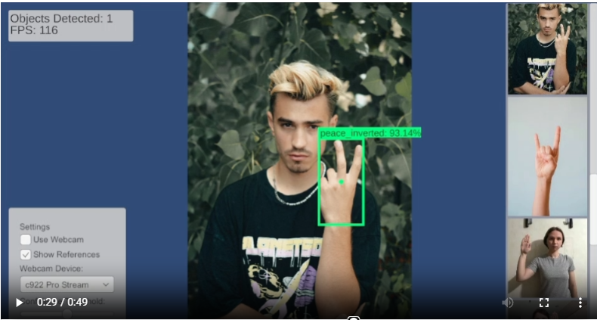
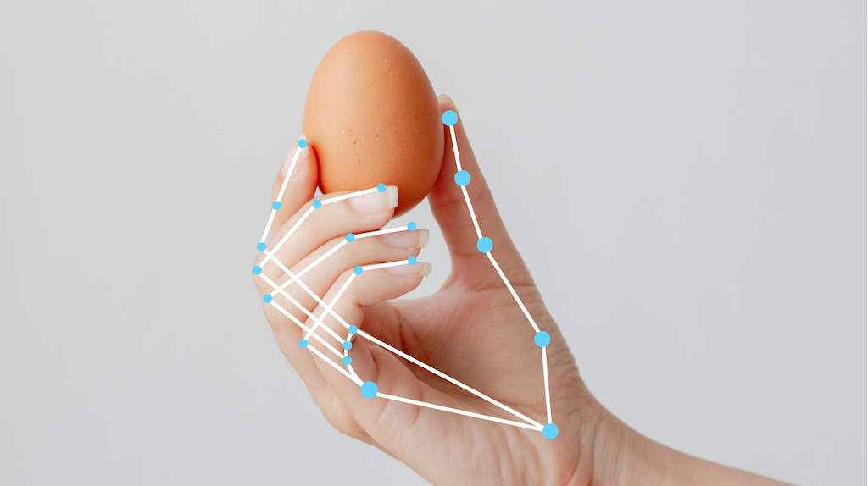
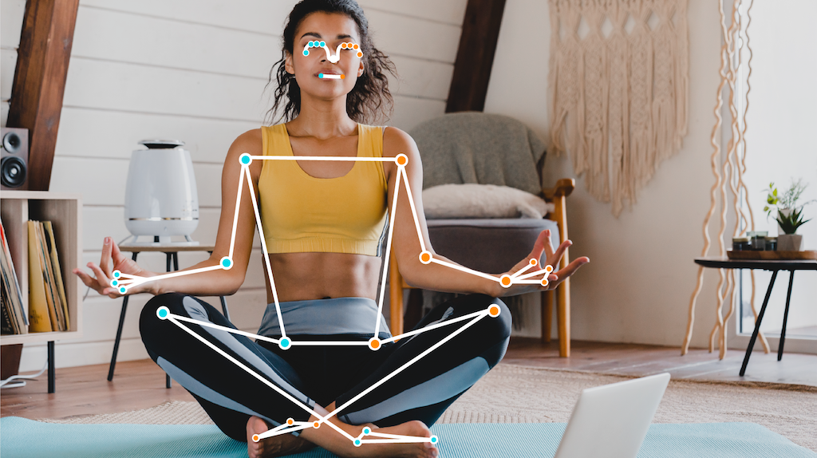
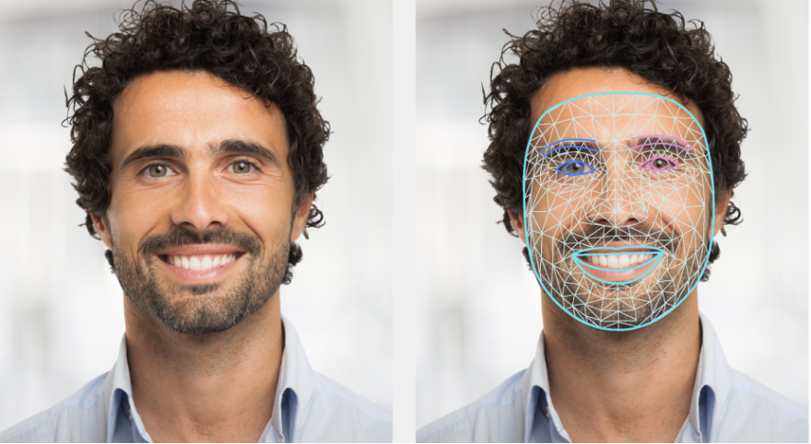
ASL Recognizer
Using PC camera, we are Tracking and analyzing the user’s hands to determine the sign he is showing.
Dataset must be varied with ASL videos To create an accurate model.
OpenCV
Google Holistic Landmark Tracking
Notes:
In order to decrease the amount of data required to train the model we are going to use Computer vision with Google Holistic in order to track the landmarks of the users video feed
Landmarks: landmarks are the key features of a person in a simplified way, baisically creating an advanced stick figure skeleton on the user.
Using the landmarks would allow us to focus on the key features of the user and get rid of all the metadata we have, as computer vision algirthms are advanved enough to recognize the landmarks it would be much easier to track them and also will be much easier to train the models as this would allow us to greatly reduce the models need for Data.
The task outputs a total of 543 landmarks (33 pose landmarks, 468 face landmarks, and 21 hand landmarks per hand) in real-time.
https://ai.google.dev/edge/mediapipe/solutions/vision/holistic_landmarker
Image from https://christianjmills.com/posts/pytorch-train-object-detector-yolox-tutorial/#wrap-the-model-with-preprocessing-and-post-processing-steps

Slide 11
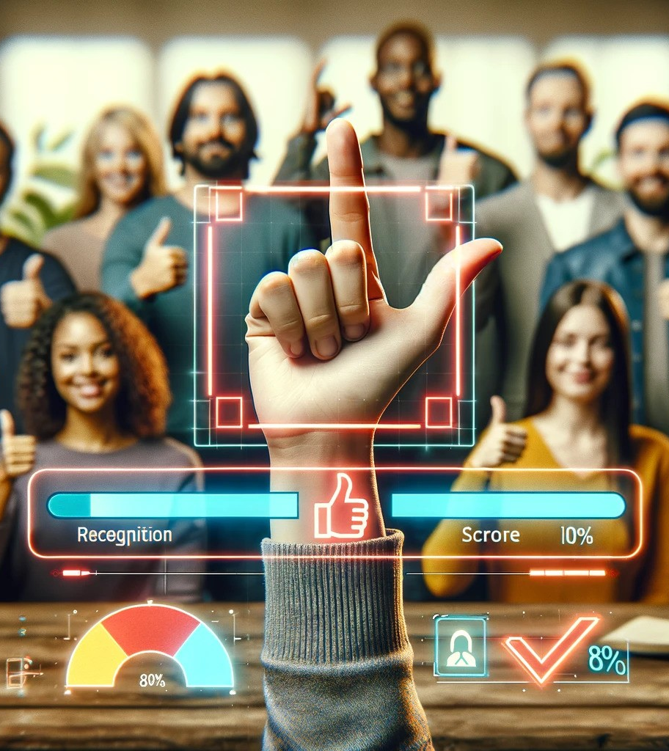
Progress Tracking
Monitoring learning progress.
Boosting confidence and motivation.
Help to fix mistakes.
Notes:
Progress tracking:
* We are creating a learning application, and as with every learning process it important to track the progress of the user to give them the feeling of success.
we will use Messages and achievements, to boost the user's confidence and motivation
By tracking the users progress we would be able to help them focus on the tasks they need improving.

Slide 12
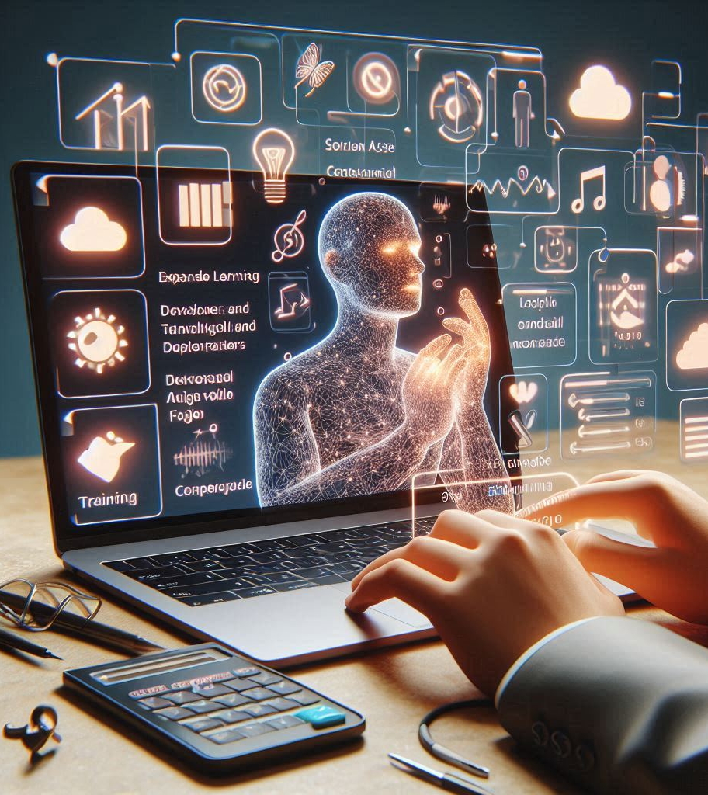
ASL Trainer Application
Key Features:
Expandable Learning.
ASL Model Training.
Generating Model File.
Frequent Updates.
Notes:
We are going to create a simple application targeted at developers and fluid sign language speakers.
The applications purpose would be to train and test the asl model
Some of the key features are:
Expandable learning: The application will allow us to collect Data for training
The collected date will be accessible and viewable within the application.
2. ASL model training: the application will allow us to Train and test the model.
3. Generating model file, the application will generate a trained model file that will then be uploaded to the could.
The updated file will then be distributed to all players upon startup of the game and thus the model will always be up to date and include all the new signs trained.
4. Frequent updates: by using cloud services we should be able to update the dataset every time the user starts the game

Slide 13
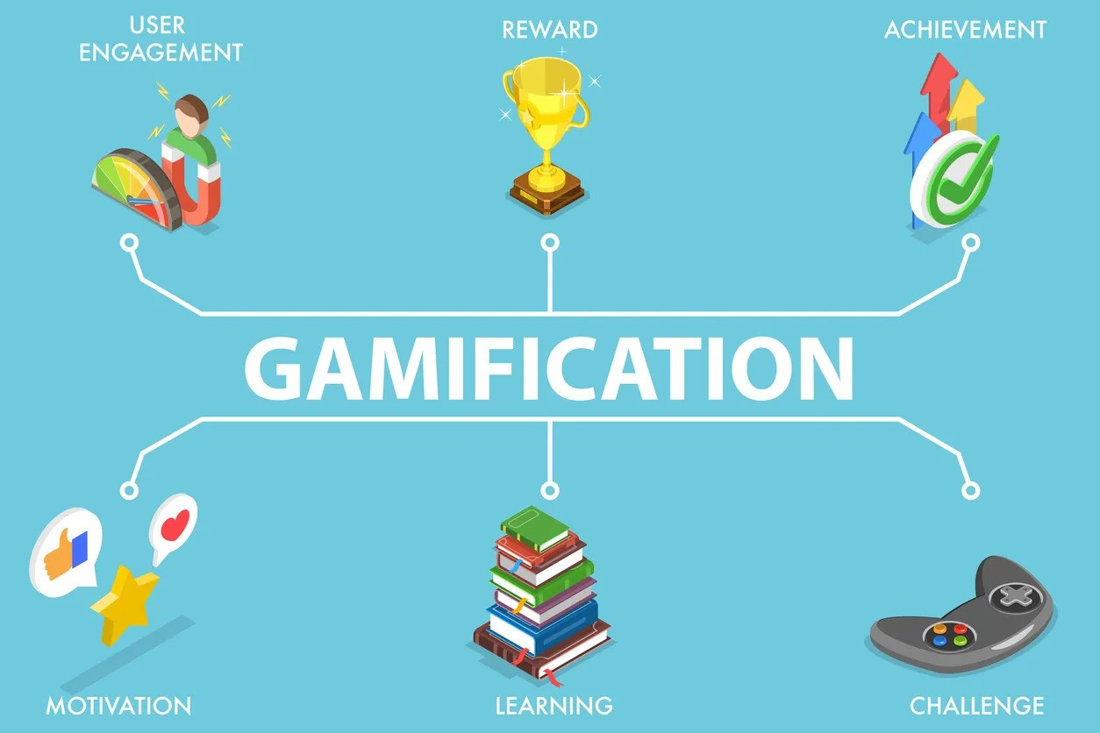
Notes:
https://blog.efmdglobal.org/2021/09/08/redefining-failure-teaching-digital-skills-with-gamification/
TODO write the concept of gamification

Slide 14
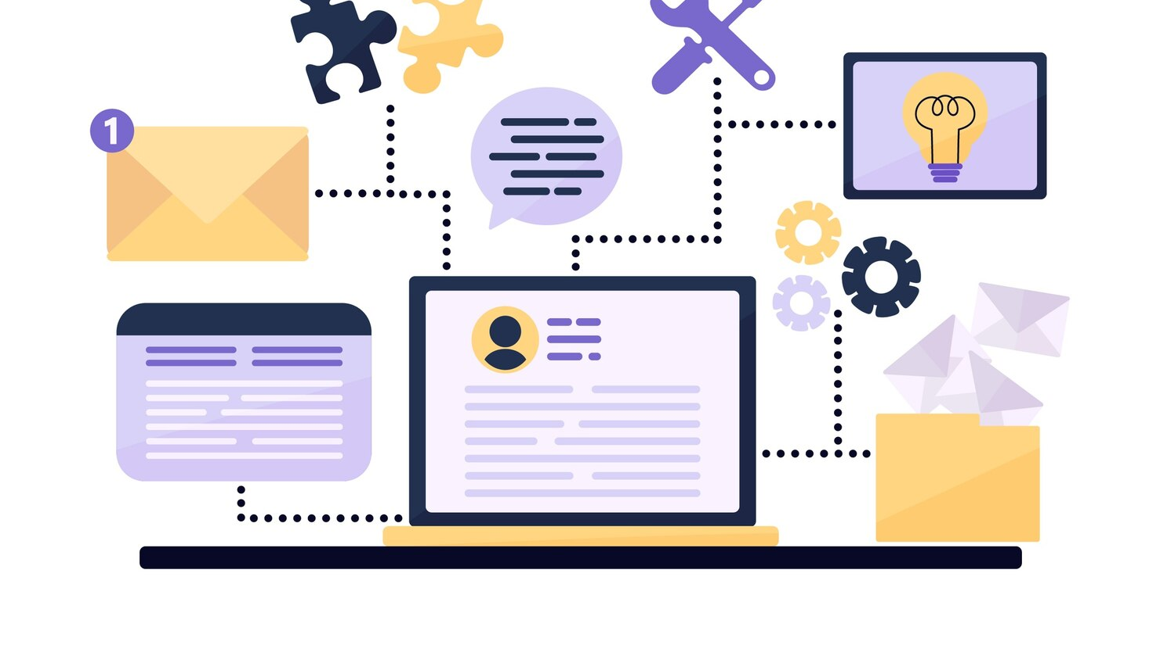
Architecture Overview
Notes:
https://www.freepik.com/free-vector/illustration-with-multitasking-concept_6555998.htm#query=software%20architecture&position=1&from_view=keyword&track=ais_user&uuid=6dd745c8-346f-4ae3-be67-adea11e4b37a

Slide 15
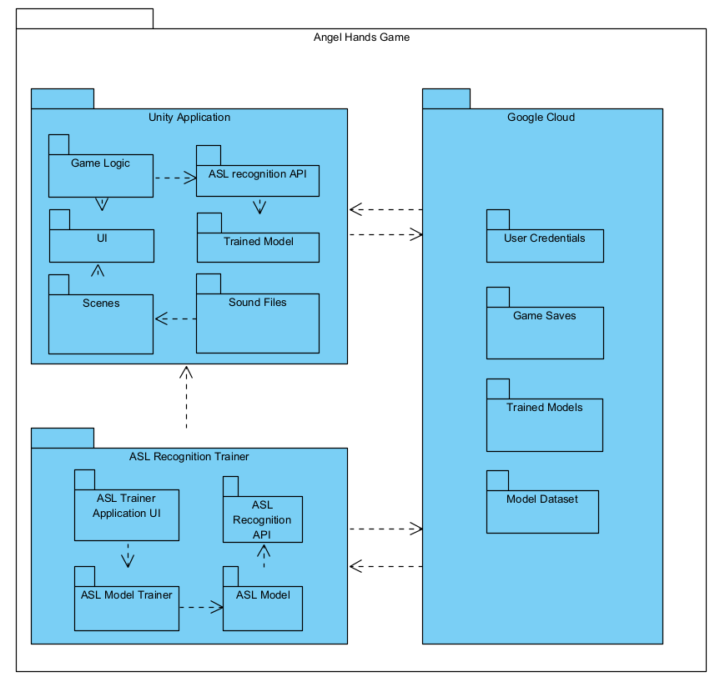
Package Diagram
Three main parts:
Unity Game
ASL Trainer Application
Cloud and DB connection
Notes:
Package diagram is composed of three main parts:
Part 1:
Unity application, that will be our game, the user interface it will include all the scenes, sound, characters and levels.
Part 2:
ASL Trainer Application: this will be an application that the purpose of which would be to collect data and train the model to get a better model over time.
Part 3:
Cloud service: we are going to need a cloud service to keep login information and game saves, this will allow the game to be played on a cross-platform basis and be accessed from anywhere anytime.
This will also be used to store our models and training data and thus allowing us to update the model version for the user every time he starts the game with new signs and more accurate recognition.

Slide 16
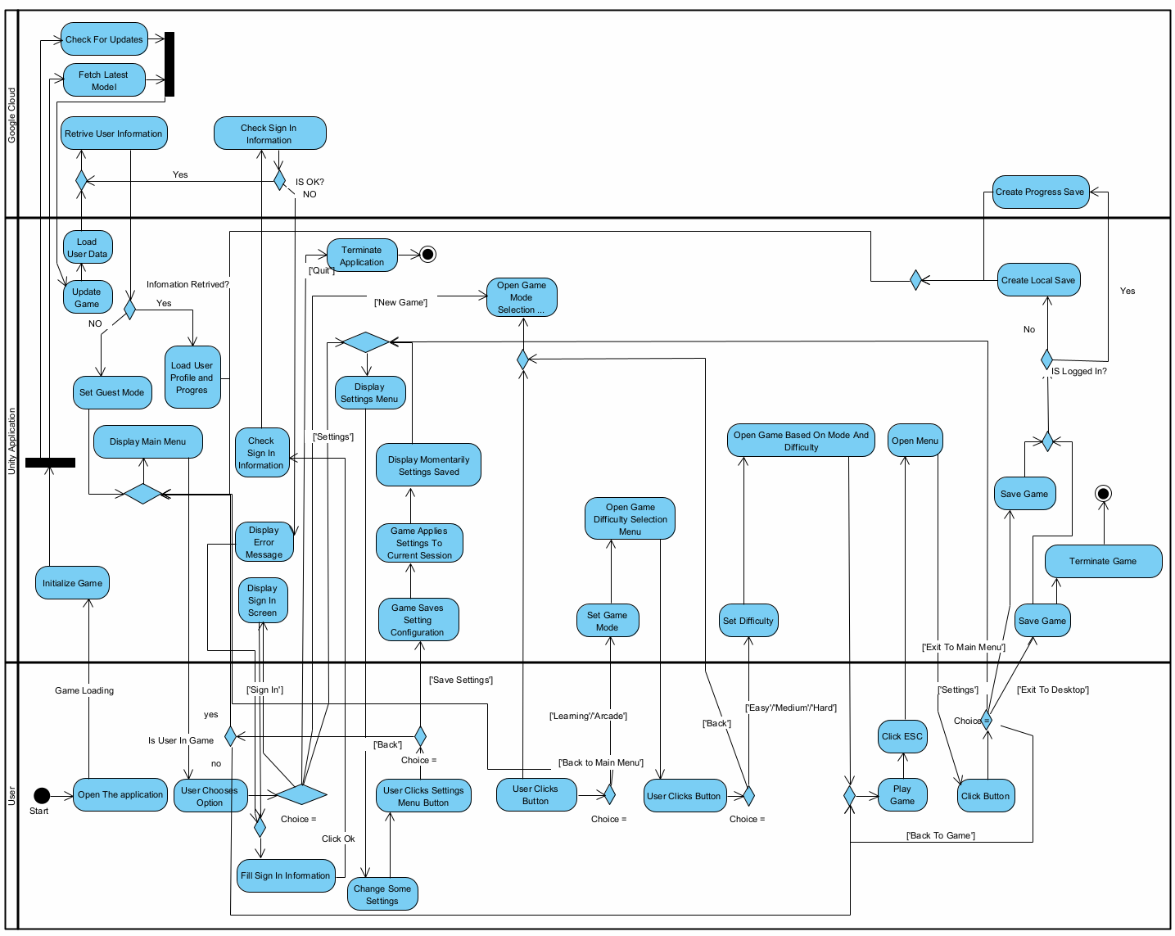
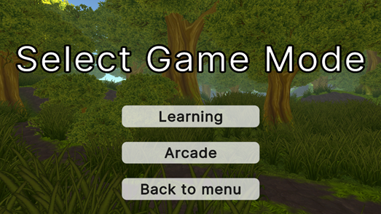
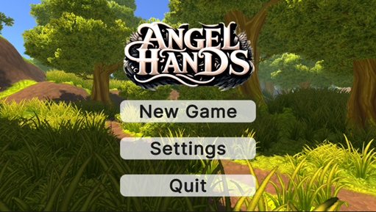
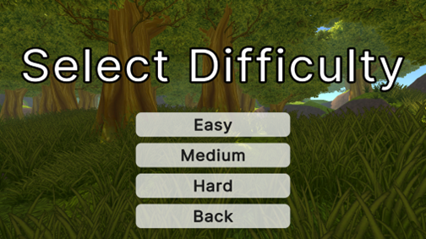
Activity Diagram
The general flow of our game.

Slide 17
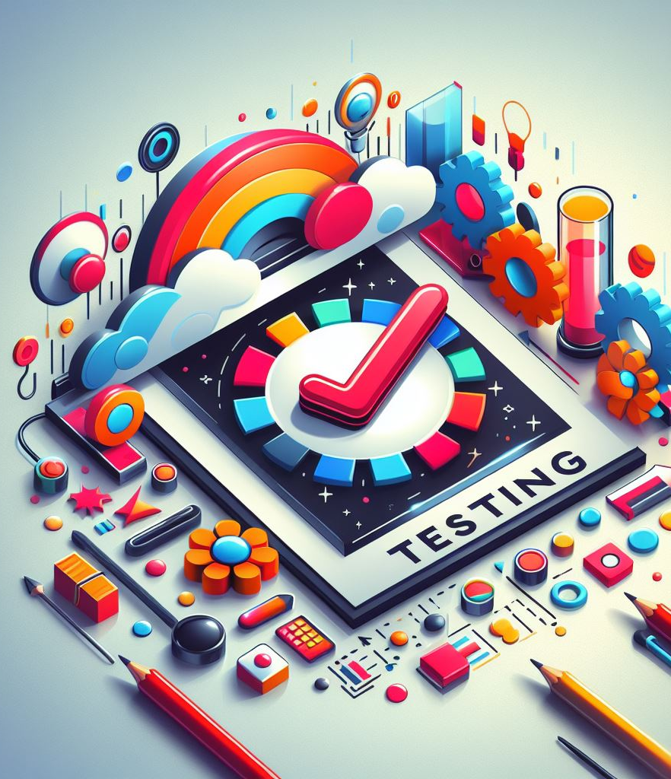
Verification and Evaluation
Testing Plan:
Ensure the quality and effectiveness
Identify potential issues
Seek areas for improvement

Slide 18
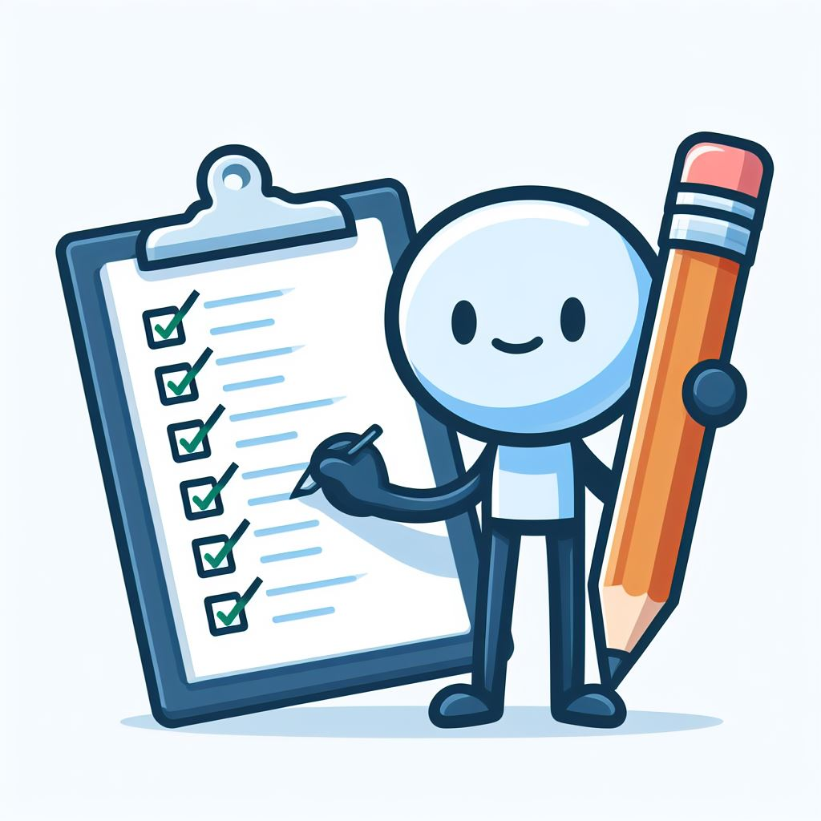
Testing Plan
Unity Application:
Scene Loading / Transitioning
3D Objects Positioning / Proportions
Data storage
Sign Language Recognition:
Correct Recognition
Quick Recognition
Accuracy Feedback
Cloud Storage:
Data Accessibility

Slide 19
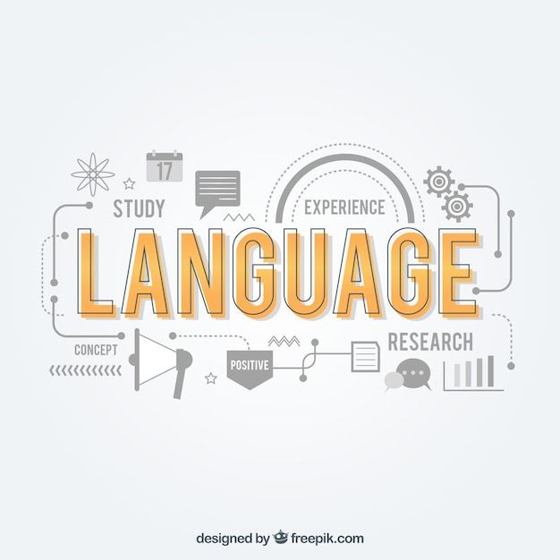
Language and communication are basic skills
that should be accessible to
everyone form everywhere

Slide 20
Thank you for watching
Notes:
https://www.freepik.com/free-vector/language-composition-with-flat-design_2776299.htm#fromView=search&page=1&position=34&uuid=c7d929ca-59d7-4756-a7fd-bc0169ee5dc4

